Slide 1

AE-4 - PROGRAMMING LANGUAGES Noelia Villahermosa García

Slide 2
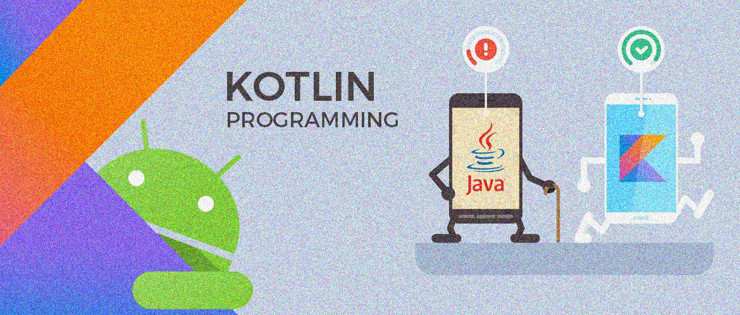
Kotlin Programming Language

Slide 3

What it is Kotlin?
Kotlin is one of the fastest-growing and widely used programming languages.In May 2017, Google announced it as an official language for developing android applications.Kotlin has a bright future, companies like Google, Netflix, Pinterest are some of the companies using Kotlin.
Kotlin is an open-source, statically typed language designed by Jet brains.It has both the features of object-oriented programming and functional programming.
In 2017, Google announced first-class support for Kotlin on Android. Later, Kotlin 1.2 was released with features like sharing code between JVM and JavaScript.After that, various versions were released, like Kotlin 1.3 in 2018, Kotlin 1.4 in 2020, Kotlin 1.5 in 2021, etc.The development of the Kotlin language was announced in the year 2011. It was released in Feb 2016.

Slide 4

Besides Android apps, Kotlin is also useful for the following:
- Server-side development. Back-end web app development traditionally uses Java. Kotlin can be used alongside Java for development on the server. Kotlin supports Java Class Libraries.
- Multiplatform mobile development. Developers use Kotlin for Android and other mobile platforms, including Apple iOS, Apple watchOS and Linux.
- Data science. Kotlin is often used for data science tasks, such as building data pipelines and putting machine learning models into production. Jupyter and Zeppelin, two popular data science tools used with Java, also support Kotlin.

Slide 5
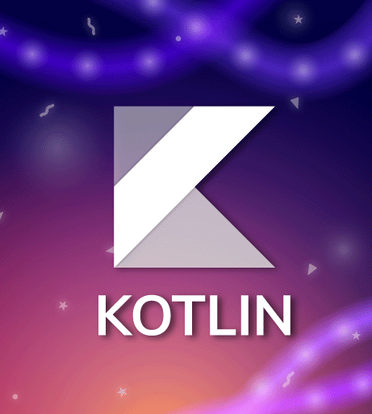
Benefits of Kotlin
Some of the advantages of Kotlin are the following:
- Interoperability. Kotlin interoperates with Java because they compile to the same byte code. Kotlin can be compiled into JavaScript or an LLVM encoder, which enables programmers to perform just-in-time compiling to ensure that code embedded in another program runs smoothly. It also shares tooling with Java. These features make it easy to migrate Java applications to Kotlin.
- Security. Kotlin is designed to help avoid common coding errors that can break code or leave vulnerabilities in it

Slide 6

Benefits of Kotlin
More vadvantages of Kotlin:
- Clarity. Kotlin eliminates some of the redundancy in the basic syntax of popular languages like Java. Kotlin is a timesaver for developers because it provides more concise code. Developers can write programs with less boilerplate code, increasing their productivity.
- Tooling support. Kotlin has tooling support from Android with tools optimized for Android development

Slide 7
Although Kotlin is a relatively new language compared to Java, it has a community of developers who work to improve the language and provide documentation.

Slide 8
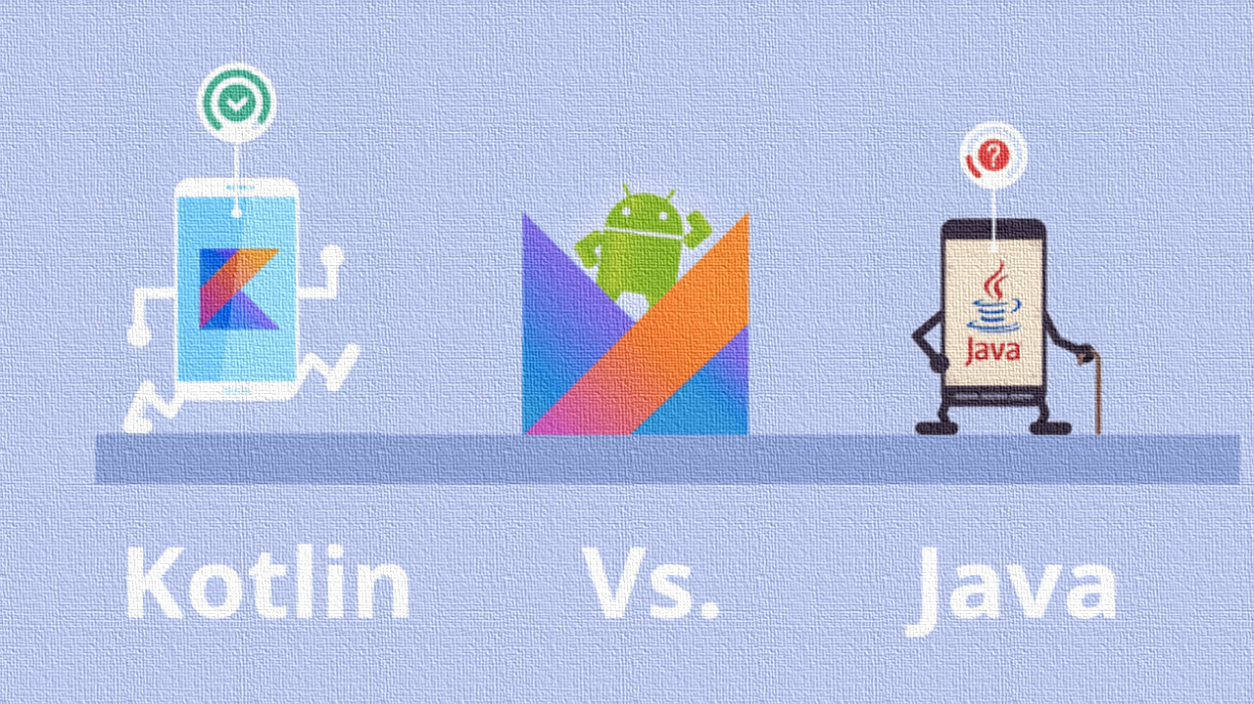
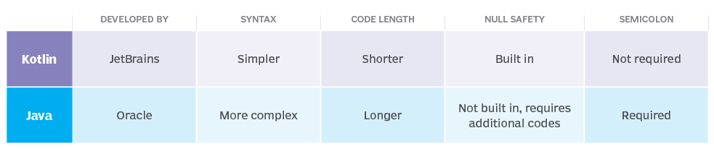
Kotlin se suele comparar mucho con JAVA, pero ¿Qué es mejor kotlin o Java?
Java puede ser más adecuado para aplicaciones de servidores empresariales, mientras que Kotlin puede ser la mejor opción para aplicaciones destinadas al sistema operativo Android.

Slide 9
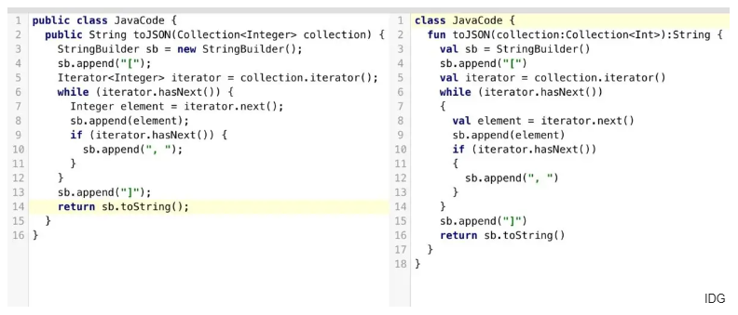
example of Kotlin vs JAVA code

